Slide 1
Updates
3.4.2015

Slide 2
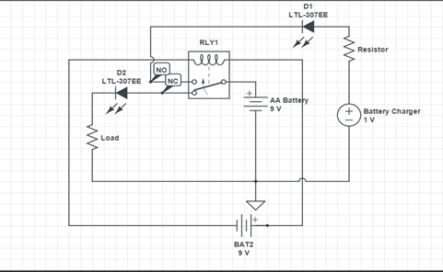
Lotanna
This Week
Construct a circuit that uses a relay to determine whether a battery
will be dissipating power to a load resistor or being charged
with the battery charger.
A 9V battery will be used to apply voltage to the coil of the relay.
As long as relay is not activated, battery will be providing power to
the resistor through the NC pin. This will be indicated by the red LED
turning on.
Once voltage is applied to coil of the relay switch automatically connects to the NO node and battery begins to charge. Blue LED comes on when this happens

Slide 3
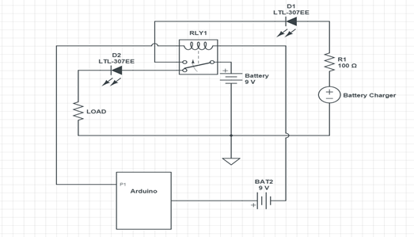
Lotanna (cont.d)
Deliverables for Next Week
Implement Arduino into circuit to read and display the voltage of the battery to determine battery life left. Knowing the voltage characteristic curve can determine at what point battery needs recharging. Depending on voltage reading, control relay to switch from power dissipation mode to charging mode.
Simple schematic:

Slide 4
Matthan
RC VEHICLES
Several Factors to consider when picking out an RC vehicle:
Scale (i.e. 1:10, 1:8, etc.)
Style, not for the look, but the shape/design of the chassis (i.e. lifted off of ground, wheels spread out, not prone to rolling over, size and tread of wheels)
Rock Crawlers are the best fit for our needs, as they are high torque low speed vehicles
The issue then becomes overheating due to traction. When a light RC vehicle is pulling a heavy RC load over terrain like grass, nonproductive resistance occurs, better known as tire slippage.
http://www.nitrorcx.com/51c875-maxstone8-green-24ghz.html More conventional design, 4x4, 2 electric motors
http://www.nitrorcx.com/03c20-madtorque-6x6-red-rtr-24g.html 3 electric motors @ $290 6x6
http://www.nitrorcx.com/03c25-mt-8x8-black-rtr-24g.html 4 electric motors @ $360 (has swiveling trailer) 8x8
Both have same battery
https://traxxas.com/forums/showthread.php?58375-How-much-weight-can-your-rc-truck-pull-in-the-dirt-how-long

Slide 5
Cameron
Proposed Deliverables from Last Week
Fix the Python module issue
Complete two python files
One to upload an image, create an array of points for the image, and alter the image using the scipy and numpy modules.
One to upload a set 2D data points and to form an image in Python from the points.
Progress
Python 3.4.3 now functions properly on my personal computer using Anaconda. I am no longer using Pycharm and now use Anaconda’s IPython Notebook.
Completed the image processing and manipulation introduction to numpy and scipy. This included tutorials on writing to image files, adjusting the points (cropping) an image, using a gaussian filter to reduce noise, and displaying arrays as images using matplotlib (additional download for 2D image plots)
Issues Encountered
Type of data being stored on the NUC needs to be discussed (3D data points, time delays, position of signals?)
When uploading 2D data points from an excel sheet, creating an array was a struggle and matplotlib was not downloading correctly at first.
Need for discussion of data stored and 2D vs 3D image

Slide 6
Cameron
Deliverables for Next Week
Once it has been discussed how the data will be stored and what it will look like, I will complete the Python code to access and upload similar data from an excel sheet/downloaded file.
Once uploaded, the data points will be formed to an array to construct a 2D image using matplotlib. Then the image will be put through different filters that are typical of GPR systems (matched filter most likely).
Work on extending knowledge of the matplotlib module
Research on typically used filters in GPR and the math behind each type

Slide 7
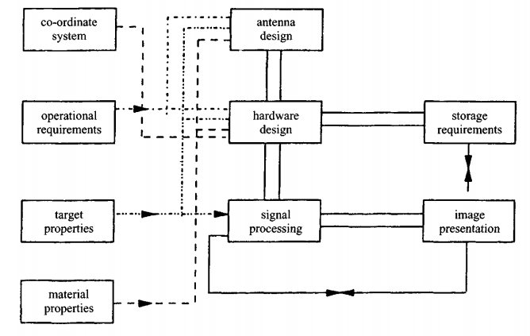
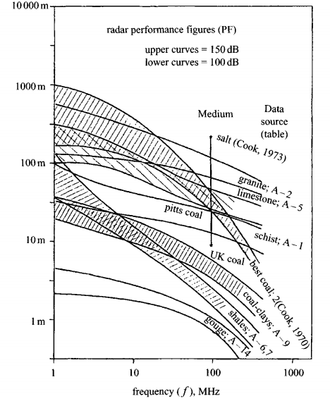
Blade
UPDATES:
Researched GPR basics. Discovered “Ground Penetrating Radar” by D.J. Daniels
Deliverables for next week: Block diagram with research on base components for GPR

Slide 8
Links
http://mysite.du.edu/~lconyers/SERDP/whatis2.htm
http://www.ire.kharkov.ua/struktura_ire/ot15/sitnik/IRE%20NASU%20%20Portable%20Radar-Set%20for%20Rescuers.htm
http://www-eng-x.llnl.gov/documents/em/gpirhardware.html
http://www.geotech1.com/forums/showthread.php?10987-looking-for-home-made-G-P-R/page2
http://www.earthsciences.osu.edu/~jeff/Library/BASICS.PDF
http://www.treasurenet.com/forums/geophysics/32729-home-made-gpr.html
http://fivedots.coe.psu.ac.th/Software.coe/mit/Ground%20Penetrating%20Radar.pdf

